Slide 1
Monitoring tools and options

Slide 4
Monitoring tools and options

Slide 5
Lesson 1: Monitoring tools and options
Purpose of monitoring
Performance baseline
PowerShell
Azure Functions
Application Insights

Slide 6
The purpose of monitoring
Discover deviations.
Create alerts for values outside of the ordinary.
Observe trends.

Slide 7
Why doesn’t Microsoft share their own…
Multi-tenant architecture:
Thousands of tenants.
Tens of thousands of sites.
Millions of pages.
Numbers are aggregated.
Hardware is different from what you have on-site:
Everything is virtualized.
Many more servers.
Dynamic adding and removing of VMs.
Notes:
But Engineering is aware of these questions

Slide 8
Why doesn’t Microsoft share their own… (cont.)
Microsoft does not know what is slow for you.
Example ULS log entries:
06/07/2017 08:49:14.97 usr16863-471:w3wp.exe (0x7008) 0x1168 SharePoint Foundation Logging Correlation Data xmnv Medium Name=Request (GET:https://contoso.sharepoint.com/sites/<PII:H1(EY1//dZNBoprW1DiXJ0YexKjPVN8YUF+bGg7cmBZWpM=)>/Pages/default.aspx) bb56f99d-1086-4000-2374-fa41418742fc
06/07/2017 08:49:14.97 usr16863-471:w3wp.exe (0x7008) 0x1168 SharePoint Foundation Claims Authentication ax9qz Medium Token Request Data: Cookie value is intialized. UserName: '0#.f|membership|<PII:H1(N7ZAnlffTCdnCXtp6/hQsjlXhOckcWuLjSexR6NLEcE=)>@contoso.onmicrosoft.com'. bb56f99d-1086-4000-2374-fa41418742fc
Notes:
But Engineering is aware of these questions

Slide 9
Why doesn’t Microsoft share their own… (cont.)
Performance goals:
performance depends on the content of the pages…
no universal goal for customized pages/sites.
ISPs and customers’ networks influence perceived performance:
But they are not monitored by Microsoft.
Your own monitoring will focus on what is important for your users.
Notes:
But Engineering is aware of these questions

Slide 10
Monitoring SPO performance - DISCLAIMER
Measurement affects performance:
Similar to, quantum uncertainty.
More monitoring means bigger impact.
The simpler/cheaper the measurement, the bigger impact it has:
Similar to, checking a broken bone.
Not optimal monitoring can cause damage and result in throttling:
For example: Opening a page every second from 30 different locations.
Notes:
It is imperative to understand that monitoring in SPO generates traffic. The simpler monitoring you use, the more impact it has on the service. This can result in throttling the whole tenant.

Slide 11
Monitoring SPO performance - DISCLAIMER
Stress test is not allowed:
See Deployment guidance for SharePoint Online portals
Problems with stress test in SPO:
Throttling kicks in on User/Tenant level.
Throttled request results are difficult to interpret.
SPO scaling can’t handle sudden and massive load increase.
One-time validation against an evolving portal.
Notes:
It is imperative to understand that monitoring in SPO generates traffic. The simpler monitoring you use, the more impact it has on the service. This can result in throttling the whole tenant.

Slide 12
Performance baseline concept
Measurement of everyday performance:
What do you want to monitor?
How do you want to represent the data?
Collect information from all performance components:
Network (RTT is minimum).
Page render counters (SPIISLatency, SPRequestDuration, g_duration, g_iisLatency, etc.).
Download times.
Needs long time data to see trends.
Notes:
RTT = Roundtrip time

Slide 13
Tools for monitoring – PowerShell
Pros
Simple.
Well known language.
No extra configuration necessary.
Cons
On-prem server is required.
No scaling (can call only a single page) and HA.
Limited connectivity (for example: one machine).
High impact on service, subject to throttling.
Notes:
Sample PowerShell script provided with the Training material
Monitoring with PowerShell
The goal is to simulate end user calls
Can automate collecting the basic performance response data (SPRequestDuration, g_duration, SPIisLatecny, g_latency)

Slide 14
Tools for monitoring – Azure Functions
Pros
Serverless solution.
Multiple languages available.
Multiple development languages and platforms.
Rich connector to Azure/O365/Dynamics services.
Increased security (SSL, function level authorization, etc.).
Cons
Leaves most of the network out, no end-to-end monitoring option.
Azure subscription required.
High impact on service.
Notes:
Monitoring with Azure Function
Goal is similar to what a PowerShell script does
No need for local machine (runs all the time)
Can leave the network out
In theory you can do more, but then you could investigate Application Insight (not to reinvent the wheel)
https://azure.microsoft.com/en-us/services/functions/
https://docs.microsoft.com/en-us/azure/azure-functions/functions-bindings-http-webhook

Slide 15
Tools for monitoring – Application Insights (cont.)
Pros
Can provide full scale analytics.
Minimum impact on the service, still can handle 30k+ injections per second.
Can collect telemetry from all client/pages.
Can monitor page load from many aspects:
Request rates, response times, and failure rates.
Dependency rates, response times, and failure rates.
Page views and load performance.
Cons
Azure subscription required

Slide 16

Tools for monitoring – Application Insights (cont.)
Notes:
https://docs.microsoft.com/en-us/azure/azure-monitor/app/app-insights-overview
https://docs.microsoft.com/en-us/azure/azure-monitor/app/monitor-web-app-availability
https://www.youtube.com/watch?v=pqZF8LjBh68
https://github.com/SharePoint/PnP/tree/master/Samples/Core.EmbedJavaScript
https://sharegate.com/blog/sharepoint-online-and-azure-application-insights
https://www.sharepointnutsandbolts.com/2017/08/SPFx-App-Insights.html

Slide 17
Tools for monitoring – Application Insights (cont.)
What is monitored:
Server-side execution (g_duration, g_iislatency).
Client-side metrics from any browser (TTFB, page render time, failures).
External calls (for example: Azure Cache, web service calls).
Exceptions.
Notes:
https://docs.microsoft.com/en-us/azure/azure-monitor/app/app-insights-overview
https://docs.microsoft.com/en-us/azure/azure-monitor/app/monitor-web-app-availability
https://www.youtube.com/watch?v=pqZF8LjBh68
https://github.com/SharePoint/PnP/tree/master/Samples/Core.EmbedJavaScript
https://sharegate.com/blog/sharepoint-online-and-azure-application-insights
https://www.sharepointnutsandbolts.com/2017/08/SPFx-App-Insights.html

Slide 18
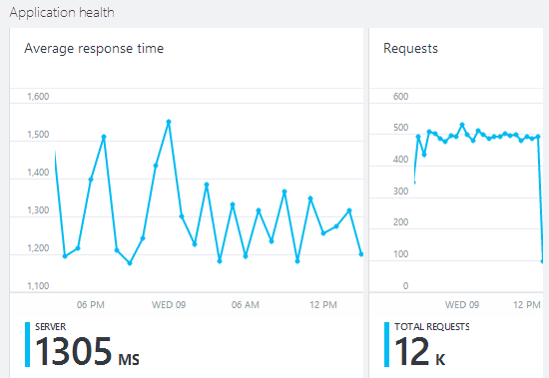
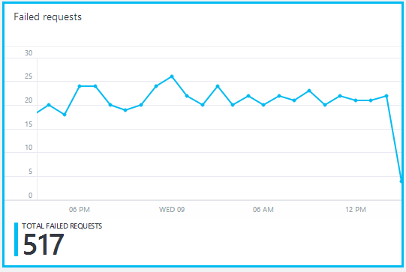
Tools for monitoring – Application Insights (cont.)
Example charts
Notes:
https://docs.microsoft.com/en-us/azure/azure-monitor/app/app-insights-overview
https://docs.microsoft.com/en-us/azure/azure-monitor/app/monitor-web-app-availability
https://www.youtube.com/watch?v=pqZF8LjBh68
https://github.com/SharePoint/PnP/tree/master/Samples/Core.EmbedJavaScript
https://sharegate.com/blog/sharepoint-online-and-azure-application-insights
https://www.sharepointnutsandbolts.com/2017/08/SPFx-App-Insights.html

Slide 19
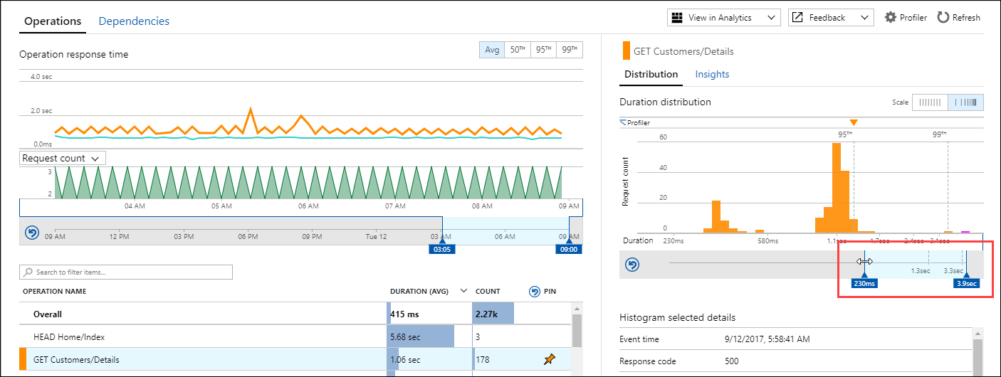
Tools for monitoring – Application Insights (cont.)
Example charts

Slide 20
Tools for data presentation – Excel
Pros
Well known, easy to use.
Usually no extra costs.
Cons
Automation is limited.

Slide 21
Tools for data presentation – PowerBI
Pros
Powerful data visualization platform with extensive data processing capabilities.
Can visualize data from files, databases, Azure, web services, etc.
Cons
PowerBI Pro license is required for sharing (free is only for public publishing).
Notes:
Can also use Google Analytics

Slide 22
True or False? Monitoring has no effect on the performance.
False. The effect depends on the chosen monitoring solution.
Why does Microsoft recommend using Application Insight for monitoring?
The impact on both the client-, and server-side is minimal. Wide range of information can be collected. Can cover most of the performance domains.

Slide 23
Your monitoring measures what you want to measure.
Monitoring has impact!
The tool you choose for monitoring affects performance.
You should be using Application Insight for monitoring.

Slide 24

Questions?
Notes:
Do not answer these yet. Bring these up now so that the students can think about their answers after we run through the rest of the modules.

